Slide 1
Reading

Slide 2
Different types of reading models
Top-down
Bottom-up
Interactive

Slide 3
Top-down approach
The goal is to get students to become active readers
Emphasis is placed on a student's engagement with the text
The experiences a reader has help him or her to read, decode, and make sense of the text
Whole to part

Slide 4
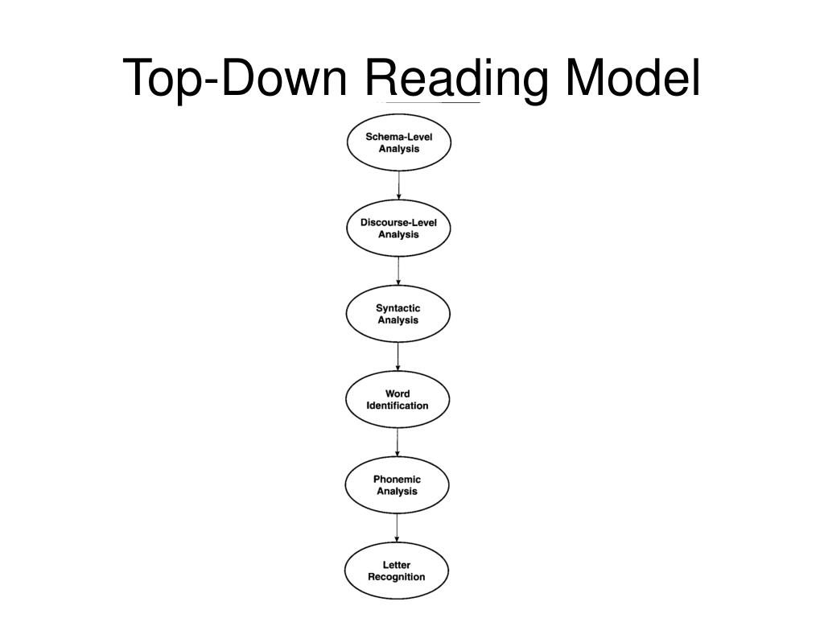

Slide 5
Bottom-up Approach
learning the basics in order to fully understand the more complex components, such as comprehension and inferences
Utilizes a building-block approach starting with the foundation of phonics and phonemic awareness
Part to whole

Slide 6
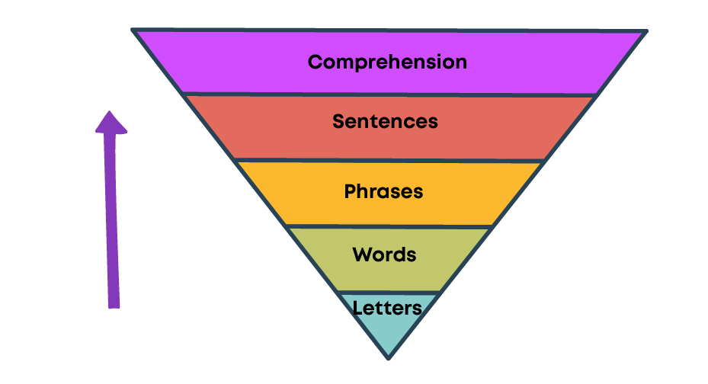
Bottom-up reading model

Slide 7
Interactive Reading Model
Recognizes the interaction of bottom-up and top-down approaches simultaneously throughout the reading process
Teachers use both instruction methods relying on phonics and a student's experiences with text, believing that each is necessary for understanding

Slide 8
Effective Reading Techniques
SQ3R reading technique
Active Reading or Critical Reading
Skimming
Scanning
Intensive or detailed reading

Slide 9
SQ3R Reading Technique
Survey -First survey the piece to get a quick idea of the content and structure of the reading. By doing this, you are preparing your mind
Question-Prepare questions for yourself to go over as you read the material
Read- Read with your questions in mind. In this step, you can combine other reading techniques that may work for you such as scanning or active reading
Recite- Now it is time to go back and answer those questions you created. Make sure what you read makes sense, and that you understand how it answers your questions
Review- Make mental notes or say aloud what you have learned. Try doing so without looking at your notes or the text to check what you have or have not retained

Slide 10
Active Reading Passive Reading
Obedient Purposelessness
Uncritical; blind trust in authorities
‘Finish a job’ mentality
Unengaged; boring and tiresome
Little understanding of the rationale
Shallow impression
Only concerned with literal meaning
Reading with questions in mind
Regard authors as respected but not infallible source of information
Intellectually interested and engaged
Critical evaluation via prediction and comparison
Deep understanding of the rationale
Deep impression
Draws inference and conclusion

Slide 11
Active Reading Strategies
Set a purpose for reading
Preview
Make a prediction
Activate prior knowledge
Annotate
Summarize the main ideas
Generate questions

Slide 12
Scanning
the process of rapidly looking through a certain text
identify particular keywords or passages you know you will need to extract important information from
Ability to locate specific information or fact as quickly as possible
Looking for meaning in a dictionary or a telephone number
Train or television schedules
Do not read everything

Slide 13
How to use scanning while reading
Since you need to do some scanning, it is implied that you already know what you should be looking for. That being said, you should first decide on a couple of keywords or phrases to search for within the text.
Try to look after each keyword separately in order to not get overwhelmed. If your goal is to identify more than one keyword, you should scan the reading material separately for each keyword.
Use your eyes to quickly scan the content and look for the desired keyword.
Whenever you encounter one of the words or phrases you are looking for, you should carefully read the sentences or paragraphs surrounding them.

Slide 14
Scanning to answer questions
Figure out the questions you want to find answers for
Read the questions and identify the most relevant keywords you should be looking for in order to find the answers
Only try to answer one question at a time. If you want answers to multiple questions, you should scan the reading material separately for each question.
When you find a keyword that indicates the answer to your question could be nearby, read the surrounding content carefully
Read the question again and try to figure out whether the content you just went through actually answers that particular question correctly and accurately.

Slide 15
Skimming
More sophisticated than scanning
A strategic, selective reading method in which you focus on the main ideas of a text
getting an overview of the text that is to check its relevance, grasp its central theme and the main points
Instead of closely reading every word, focus on the introduction, chapter summaries, first and last sentences of paragraphs, bold words, and text features
extracting the essence of the author’s main messages rather than the finer points
With skimming, you’ll be able to cover vast amounts of material more quickly and save time for everything else that you have on your plate
is also an efficient way to refresh your memory of large amounts of material before an exam

Slide 16
How to properly skim when reading
Check the title, table of contents, and the name of the chapters to understand how the content is structured and where certain ideas and concepts are being explained.
Look at the headings in each chapter to better understand how the information is structured and where you can actually find all the relevant data.
Read the first paragraph and the first and last sentences of the next couple of paragraphs.
While leafing through the content, stop to read the bolded or italicized text.
Only when a particular piece of information pops up while leafing through the book, stop and read the entire sentence containing particular keywords.
If available, read individual chapter summaries.

Slide 17
Intensive Reading
Reading for detailed information when the aim is to understand the material in-depth
most labor-intensive and time-consuming reading technique
Readers carefully read, consume, and analyze each word for meaning
Use this method with:
scholarly research articles
medical reports
poetic literature

Slide 18
Other Types of Reading Skills
Extensive Reading- used when we read for pleasure with emphasis on understanding the overall meaning. It may involve a lot of skimming like skipping irrelevant passages.
Word for Word Reading- It requires slow, careful and analytical reading. People use this type of reading to understand unfamiliar words and concepts.
Speed Reading- A skill that is acquired after much reading practice. The more you read, the more your mind adapts itself to this sort.

Slide 19
5 Ways to read faster and smarter
Know what you are reading and why
Identify key information
Increase your understanding
Recall and review the text
Control your reading environment

Slide 20
Reading Comprehension Skills
Skim the passage cautiously for overall understanding and to grasp the main idea
Read it for the second time for intensive reading to get the contextual meaning of words, phrases, sentences and writer’s thought process
Increase the study reading speed and it comes with practice
Go through the questions carefully
Read the passage for the third time looking for the answers of the given questions
Answer the questions in the given order. Come back to the unanswered questions later on
Answer to the point. Follow the given word limit.
Check your answers for correctness, grammar, spelling and relevance

Slide 21
Strategies in Good Comprehension
Previewing the text by looking at the title, the pictures, the graphics, and other relevant items (chapter headings, summaries, etc.), to evoke ideas, thoughts, and relevant memories and experiences. This starts to activate what a reader already knows; it “primes the pump.”
Predicting from the preview what is already known about the topic, content, and/or genre that can help the reader understand, as well as what is known about the form of the reading material.

Slide 22
Continued
Setting purposes for reading by asking questions that need to be answered.
Choosing an appropriate strategy based on predictions and questions (“I’m going to skim this quickly to find out where he is,” or “I am going to read the summary of this physics chapter first to get the overall gist”).
Checking understanding by keeping track of the gist of the material. This can be done by paraphrasing, by imaging, or by asking, “Does this make sense?”
Looking for any contradictions or inconsistencies
Pay special attention to transition words

Slide 23
Continued
Integrating the new information with what is already known by making connections, making inferences, creating images, or adding elaborations to what the author says.
Monitoring comprehension by using all cueing systems to figure out unknown words, by determining what is important in the reading material, and by using “fix-up” strategies (such as rereading and reading ahead) when difficulties are encountered.
Make a note of unfamiliar vocabulary words
Continuing to predict/question, to refine those predictions and answer or reformulate the questions, and to ask new questions.

Slide 24
Strategies employed after reading
Summarizing and synthesizing what has been read by dealing with the plot and/or central ideas, as well as the author’s purpose and perspective.
Responding appropriately: personally, critically/evaluatively, and/or creatively.
Reading multiple sources and cross-checking information when appropriate, or making other connections across texts and knowledge types.
Checking for fulfillment of the purpose of reading. Were questions answered? Was the author’s presentation adequate? Does the reader need or desire to read or learn more or search further for information?
Using what is read in some application.

Slide 25
Let’s Practice

Slide 26
First Passage
I tend, as a reader, to prize and admire clarity, precision, plainness, lucidity, and the sort of magical compression that enriches instead of vitiates. Someone's ability to write this way, especially in nonfiction, fills me with envy, and awe. That might help explain why a fair number of Best American Essay pieces tend to be short, terse, and informal in usage/syntax. Readers who enjoy noodling about genre might welcome the news that several of this year's Best Essays are arguably more like causeries or propos than like essays per se, although one could counterargue that these pieces tend, in their essential pithiness, to be closer to what's historically been meant by 'essay.' Personally, I find taxonomic arguments like this dull and irrelevant. What does seem relevant is to assure you that none of the shorter essays in the collection were included merely because they were short. Limpidity, compactness, and an absence of verbal methane were simply part of what made these pieces valuable; and I think I tried, as the Decider, to use overall value as the prime triage - and filtering mechanism in selecting this year's top essays.

Slide 27
Questions
The author of the passage is primarily concerned with:
A)Cataloguing the formal qualities of writing that coincide with traditional essays. B) Educating readers about literary genres. C) Explaining what characteristics of writing interest him most. D) Defending the criteria by which he chose the essays that appear in the collection. E) Criticizing essays that do not conform to a prescribed format.
2. The passage supports all of the following EXCEPT:
A) Conciseness and language use are only one aspect of what gives an essay worth. B) Essays that vary in length, style, and formality are inferior to those that follow strict rules. C) Taxonomy cannot always apply to writing in the same way it does to scientific concepts. D) The length of a piece cannot be considered in evaluating the merit of its ideas. E) Economy of language can give life to an essay rather than destroy it

Slide 28
Continued
3. In context, the author refers to causeries (informal writing or conversation) and propos (exchange of spoken words) primarily in order to
A) Demonstrate that all nonfiction essays are informal in their very nature. B) Argue that spoken language is superior to written language. C) Prove that essays, like conversation, are best when pithy and exact. D) Essays must differ considerably from speech in order to fit the nonfiction essay genre. E) Explain that an effective essay can have casual elements and need not always follow strict guidelines exactly

Slide 29
Second Passage
Werner Hoeflich spent the evening at his catering job, making white-wine spritzers and mixing vodka with Tab in a spacious apartment overlooking Central Park. There were orchids, thick rugs, a dog with long blond hair. He walked home late from the subway afterward, along the gated and padlocked streets of the Upper East Side. The trees on his block were scrawny and impervious, like invalid aunts.
Once he had seen a parakeet in one of those trees, staring down at him, shifting from foot to foot. The bird had sharpened both sides of its beak on the branch and then made a veering, panicky flight to a windowsill far above. Most of Werner's metaphorical moments were painterly - the juxtaposing of the wild bird and the tame tree, the shimmer of the periwinkle, the splurt of titanium white that fell from it onto the pavement. He loved New York for its simple surprises, although in truth, Oregon and Iowa and Arizona and everywhere else had simple surprises as well. Cantaloupe-colored sunrises, banded cows, Dairy Queens, all kinds of things that didn't include black plastic mountains of trash and the smell of dog urine.

Slide 30
Questions
The author takes multiple perspectives when describing New York. What two tones are primarily utilized? A) Impressed and critical B) Sardonic and optimistic C) Detached and Jovial D) Ominous and fanciful E) Pompous and loving
With which of the following statements would the author of the passage most likely agree? A) Every aspect of New York is unique and admirable. B) Oregon, Iowa, and Arizona do not have any geographical merit. C) A single location can have many facets, both positive and negative. D) Large cities tend to lack whimsical and artistic sights. E) Smaller, Midwest locations are superior to large, urban spaces.
Which of the following CANNOT be inferred about Werner from the passage? A) He is a creative and imagistic thinker. B) He is very biased in favor toward the Upper East Side of New York. C) He does not live at the same level of luxury as those he works for. D) He is observant, noticing both the affluent aspects of the city as well as its grimier ones. E) He is fascinated and intrigued by colors.

Slide 31
THANK YOU

